Slide 1
Android UI design
Jilin University

Slide 2
DBscan clustering parameter reference record
Adjustable parameters：eps,min_samples
结果：全部UI图片归为一类
第二次：将eps调为0.0000001，min_samples不变
可将图片分类，分类的标签结果如下，
 | eps | min_sample | The number of clusters | Noise point number | Abnormity point
1 | 0.5 | 5 | 1 | 0 | 4314
2 | 0.0000001 | 5 | 42 | 57 | 3467
3 | 0.0000001 | 10 | 21 | 3387 | 362
4 | 0.00000001 | 5 | 57 | 1008 | 1090

Slide 3
记录总结
According to DBscan clustering principle, when the number of clusters is small, the number of clusters can be adjusted by reducing EPS or increasing min_sample.
Normally, when EPS = 0.5 and min_sample = 5, only one kind of data set can be classified. So when min_sample is unchanged, the data set can be classified by setting EPS to 0.0000001, but at this time, there is a problem that a cluster is too large. So when EPS is unchanged, increase min_sample to 10, reduce the number of clusters by half, and the maximum cluster is only about 300, but there are too many noise points. In the third test, in order to reduce the number of noise points, min_sample was set to the default value of 5, and EPS was reduced ten times to 0.00000001. The number of clusters increased significantly, although the number of noise points decreased, but still very large.

Slide 4
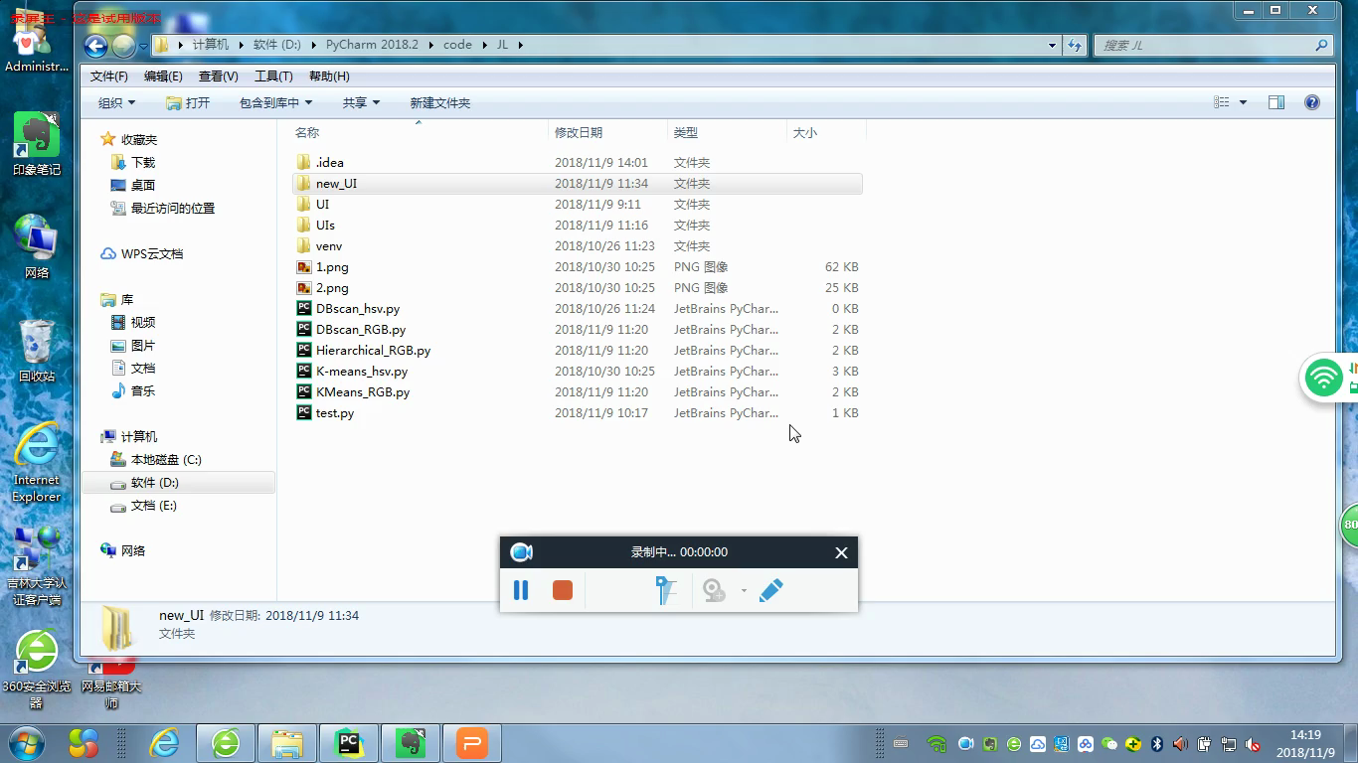
eps=0.0000001，min_samples=5

